Slide 1
Ho Chi Minh city University Of Technology and Education
Faculty of Information Technology
REPORT
Subject: Data Mining
Title: Predict traffic jams time at intersections
Teacher: MSc. Quach Dinh Hoang
Group 6
AIRLINE

Slide 2
Task
Trần Công Tuấn Mạnh | Gradient Boosting model
Trần Phát Đạt | Linear model, Data preprocessing
Nguyễn Lâm Sơn | Overview, Data preprocessing
Trần Quốc Tuấn | KNN, Random forest model

Slide 3
Content Reports
1
2
3
4
The Goal Of The Subject
Data Overview
Algorithms Apply
Conclusion

Slide 4
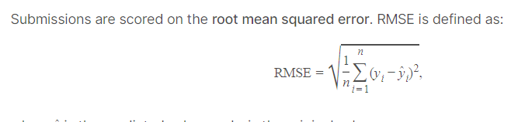
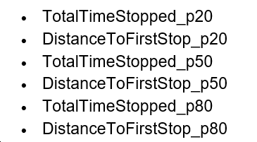
GOAL OF THE PROJECT
Analyze the Geotab Intersection Congestion dataset
1. use regression algorithm to predict traffic time at intersections
2. combine the other algorithms to compare results and choose the better algorithm for this project
Regression methods
* random forest regressor
* K-nn
* linear regression
* gradient boosting

Slide 5
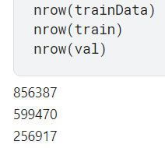
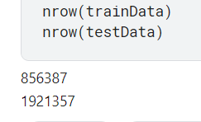
Data Overview
After data processing

Slide 6
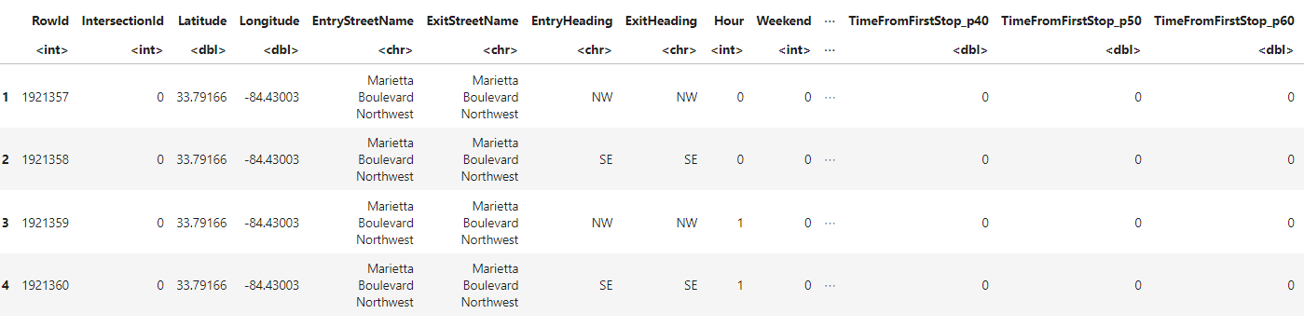
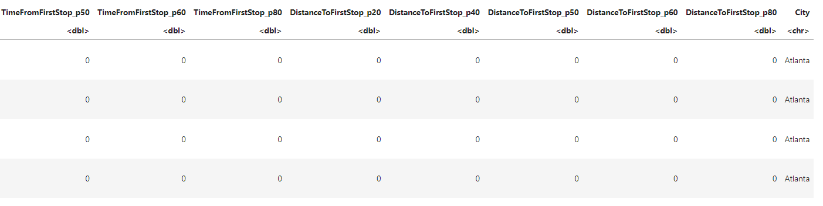
Data Overview

Slide 7
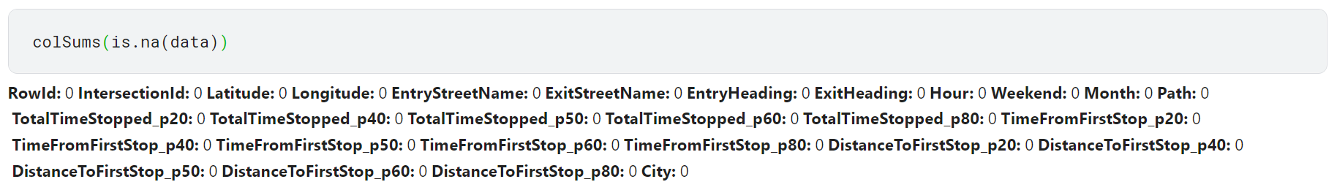
Data Preprocessing

Slide 8
Data Preprocessing
Label Encoder:
Category -> number
EntryStreetName
ExitStreetName
EntryHeading
ExitHeading
Path
City

Slide 9
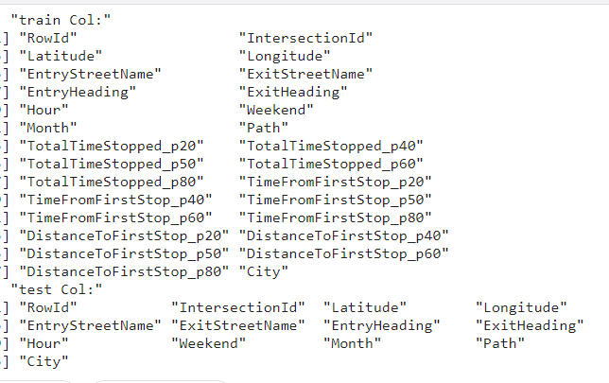
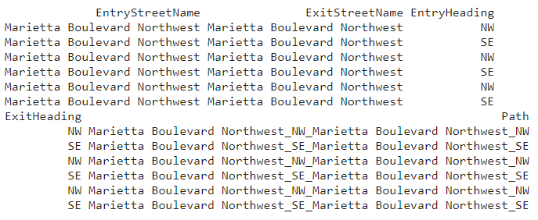
Data Preprocessing

Slide 10
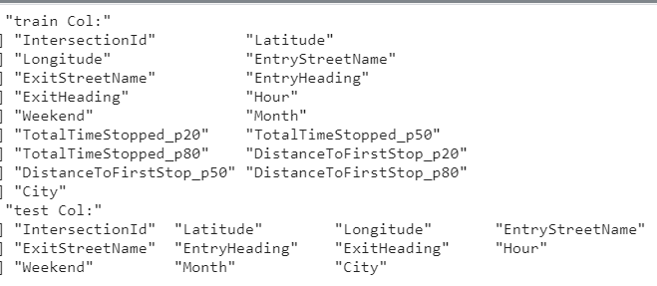
Data Preprocessing

Slide 11
Algorithms Apply
Linear Regression
KNN
L
K
Random forest
R
G
Gradient Boosting

Slide 12

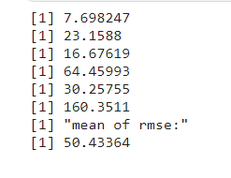
Algorithms Apply
Linear
X:
y:

Slide 13
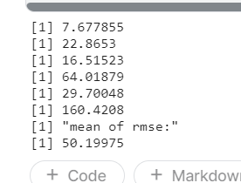
Algorithms Apply
KNN
X:
y:

Slide 14

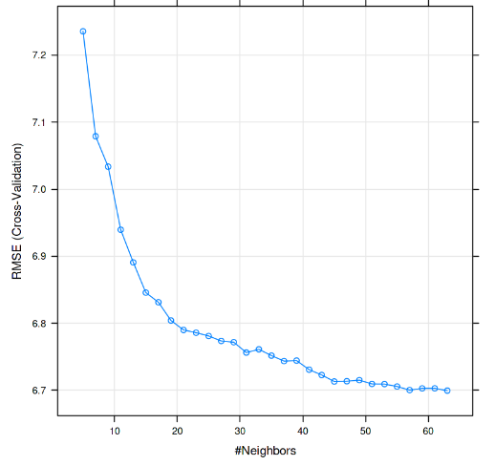
Algorithms Apply
KNN

Slide 15
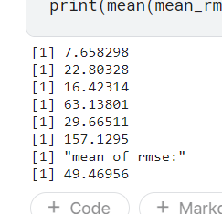
Algorithms Apply
Random Forest
y:
X:

Slide 16
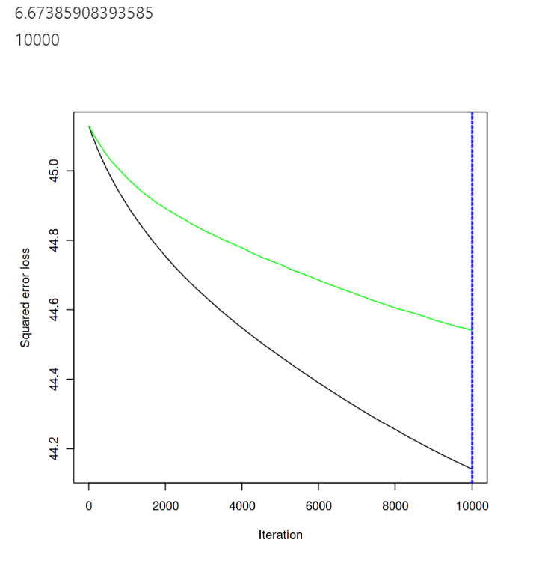
Algorithms Apply
gbm
RMSE
distribution = "gaussian",
data = train_geo,
n.trees = 10000,
interaction.depth = 1,
shrinkage = 0.001,
cv.folds = 5,

Slide 17
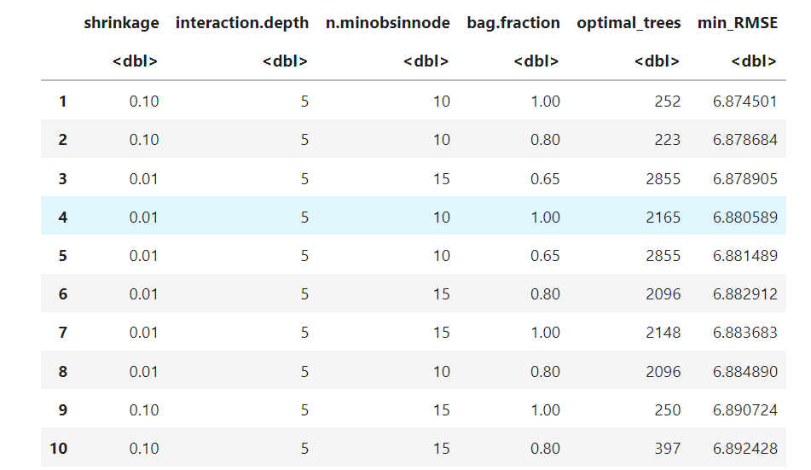
Algorithms Apply
gbm
shrinkage = c(.01, .1, .3),
interaction.depth = c(1, 3, 5),
n.minobsinnode = c(5, 10, 15),
bag.fraction = c(.65, .8, 1),
optimal_trees = 0,
min_RMSE = 0

Slide 18
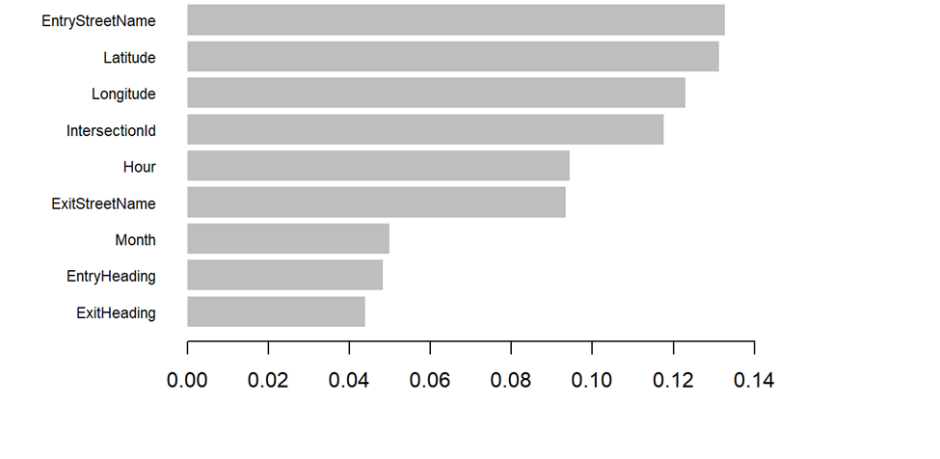
Algorithms Apply
gbm

Slide 19
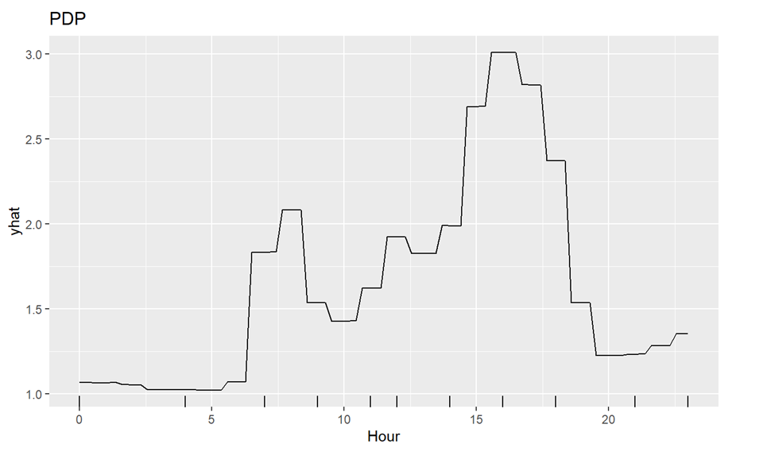
Algorithms Apply
gbm

Slide 20
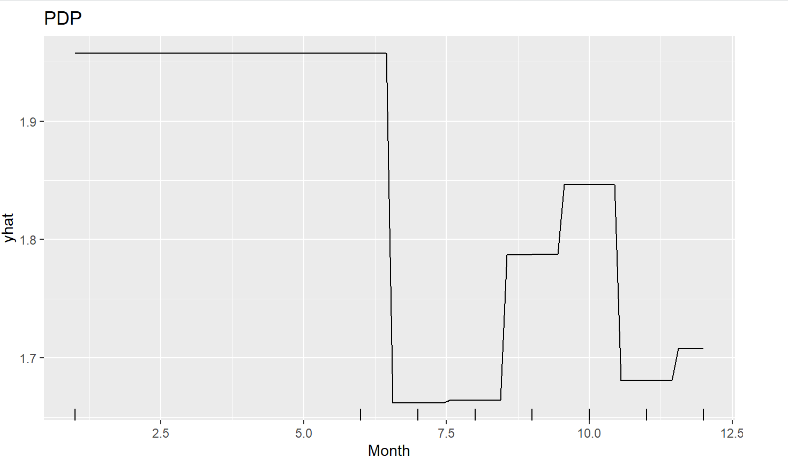
Algorithms Apply
gbm

Slide 21
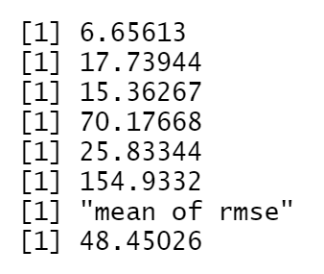
Compare
Linear
KNN
Random forest
Gradient Boosting

Slide 22

Conclusion
Gradient boosting

Slide 23
Thanks
for watching

